Slide 1
LECTURE: 7
PROBLEM SPACES AND SEARCH

Slide 2
What is Production System?
Framework for modeling complex problem-solving tasks.
consisting of:
Rules: Defined as condition-action pairs.
Memory: Tracks the system's current state.
Strategy: Determines rule application order.

Slide 3
Key Components of a Production System:
Knowledge Base: Stores rules and facts.
Inference Engine: Applies rules to facts.
Forward Chaining: Data-driven deduction of facts.
Backward Chaining: Goal-driven search for data.
Working Memory: Holds system's current state.
Control Mechanism: Manages rules and system flow.

Slide 4
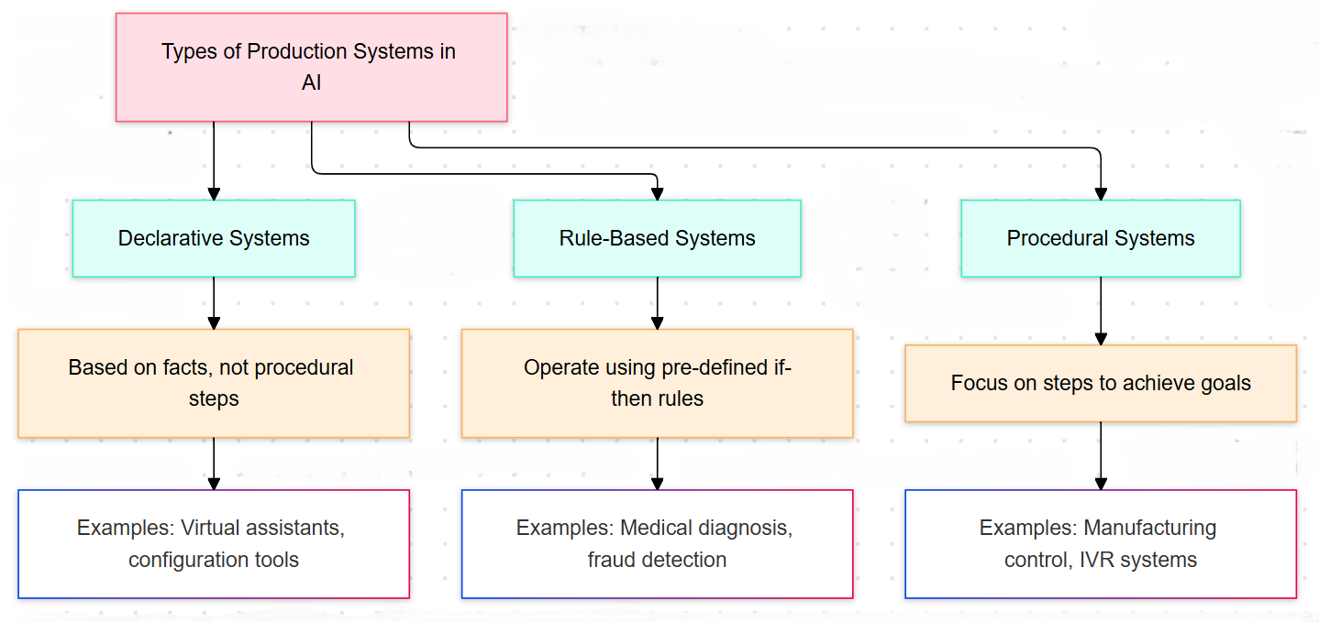

Slide 5
How Production Systems Function?
Match: Identify rules triggered by current facts.
Select: Choose a rule based on criteria.
Execute: Apply rule, updating working memory.

Slide 6
Problem Characteristics:
1. Is the problem decomposable?
2. Can steps be ignored or reversed?
3. Is the universe predictable?
4. Is the solution absolute or relative?
5. Is the solution a state or a path?
6. How important is knowledge in solving?
7. Does the task require human interaction?

Slide 7
Production System Characteristics:
Monotonic Systems: Rules don’t stop other rules later.
Nonmonotonic Systems: Rules can block future rules.
Partially Commutative: Rule order doesn’t change the result.
Commutative Systems: Both monotonic and order-independent.

Slide 8
Issues in designing search problems:
1. State Space Complexity:
Large state space leads to explosion.
Solution: Pruning, heuristics reduce unnecessary exploration.
2. Search Algorithm Efficiency:
Balancing time, space, solution quality difficult.
Solution: Combine algorithms, utilize parallel searches.

Slide 9
3. Memory Management:
Large search trees exhaust memory quickly.
Solution: Iterative deepening, memory-bounded algorithms help.
4. Heuristic Design and Evaluation:
Poor heuristics mislead or slow searches.
Solution: Admissible, consistent, learning-based heuristics improve.

Slide 10
5. Dynamic and Uncertain Environments:
Unpredictable changes disrupt search strategies.
Solution: Replanning, probabilistic methods ensure flexibility.
6. Scalability:
Large problems overwhelm traditional algorithms' limits.
Solution: Hierarchical search, distributed systems scale efficiently.

Slide 11
7. Goal Ambiguity and Multiple Goals:
Vague goals create confusion in searches.
Solution: Multi-objective, fuzzy methods resolve ambiguity.
8. Performance vs. Accuracy Trade-offs:
Real-time systems need fast, approximate solutions.
Solution: Anytime algorithms, approximations balance trade-offs.

Slide 12

Next: Navigating the Maze of Search Strategies!

